Slide 1
AI Final Project
Scott Miller, Julian Ronda, Nate Olsen, Brandon Rinderle, Zach Campo

Slide 2
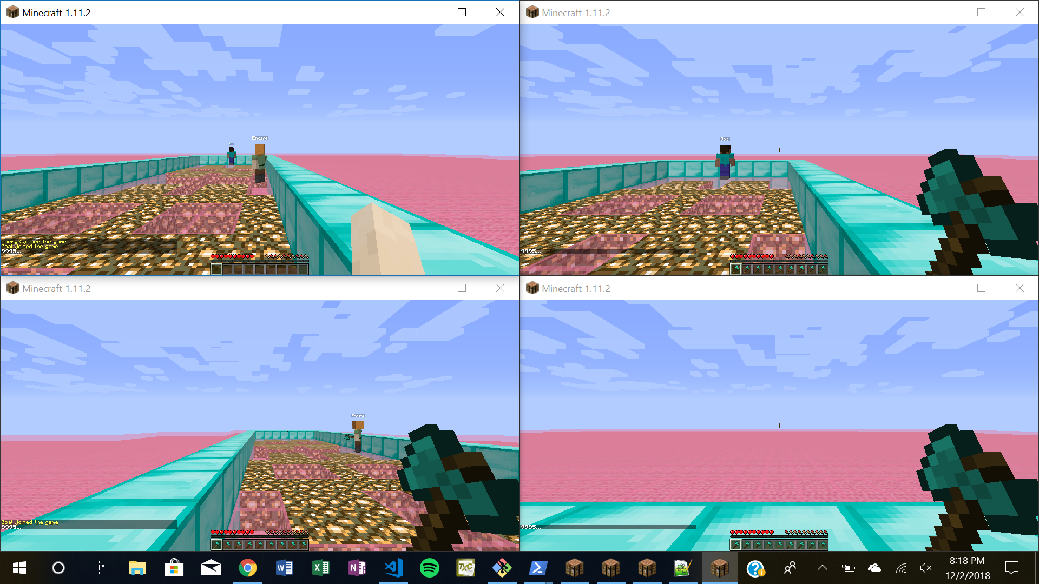
What we are doing
One Player
Two Enemies
One moving goal state
Food
Notes:
Julian

Slide 3
How the game works
Player’s objective is to eat all of the food and then catch the moving goal without being caught by the enemy players
Enemy players have a 40% chance of moving towards the player
Game ends when player moves to all food and then reaches the goal player or player touches enemy
Notes:
Julian

Slide 4
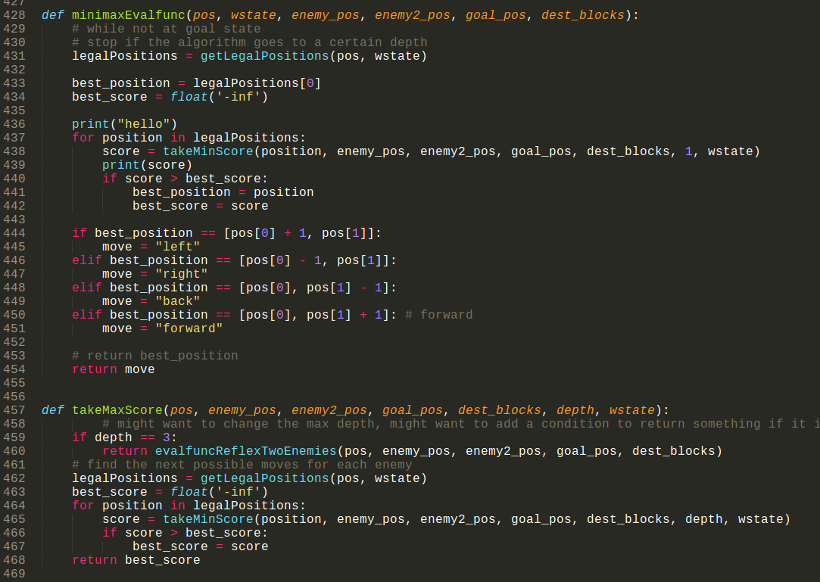
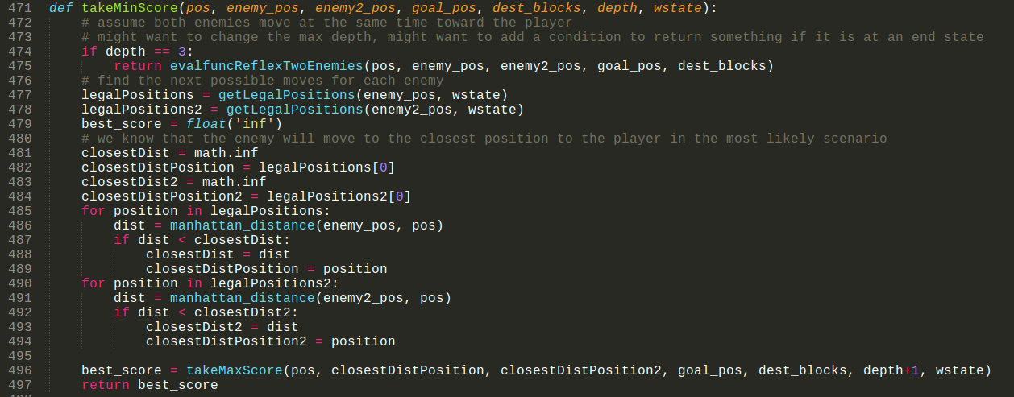
What algorithm we are using
Minimax Algorithm
Modified Reflex function from HW2

Slide 5
Procedure
Started with Evaluation function to prioritize food then goal state
Adjust evaluation function to consider two adversaries, not one
Created a Minimax algorithm, using the evaluation function

Slide 6
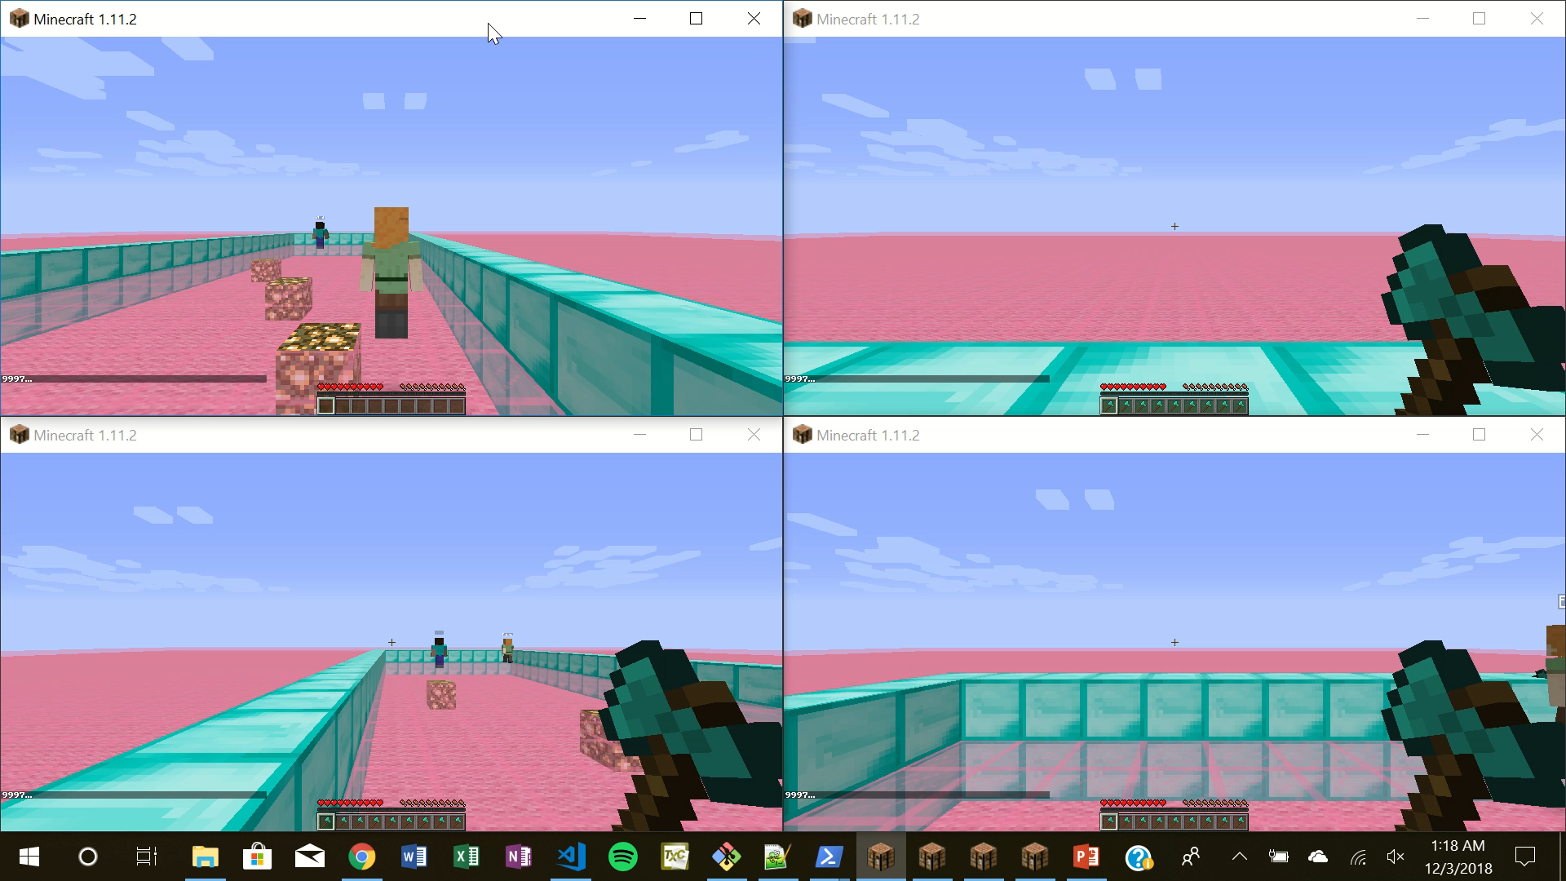
Video Demo

Slide 7
Goal of the Project
To test and take data on the effectiveness of the Minimax algorithm
Run our regular 2-adversary reflex algorithm and our Minimax algorithm on the same maps, taking performance data
Notes:
Scott

Slide 8
Real World Applications
Pac-Man
Multiplayer Online Battle Arena Games (MOBA)
Notes:
Nate

Slide 9
Testing
Compare Minimax algorithm with modified evaluation function from HW2
New scores for food and reaching goal player
-1 for player movement, 25 for finding food, 300 for reaching moving goal, -300 for touching enemy
Test difference in time and score

Slide 10
Problems we’ve had
Running 4 minecraft instances on one computer
Slow
Instances crash
Malmo connection issues
Lots of Malmo overhead including setting up the environment for more agents
Notes:
Scott

